Slide 1
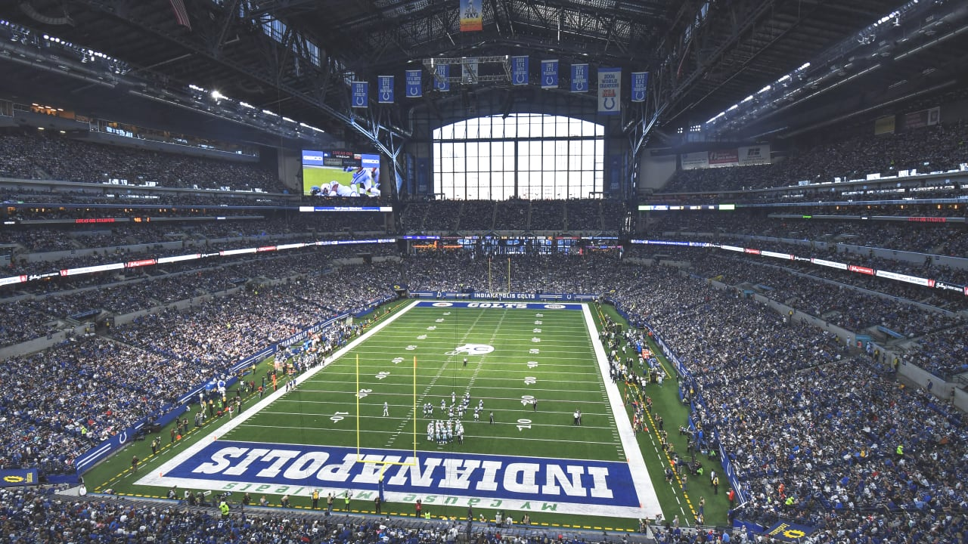

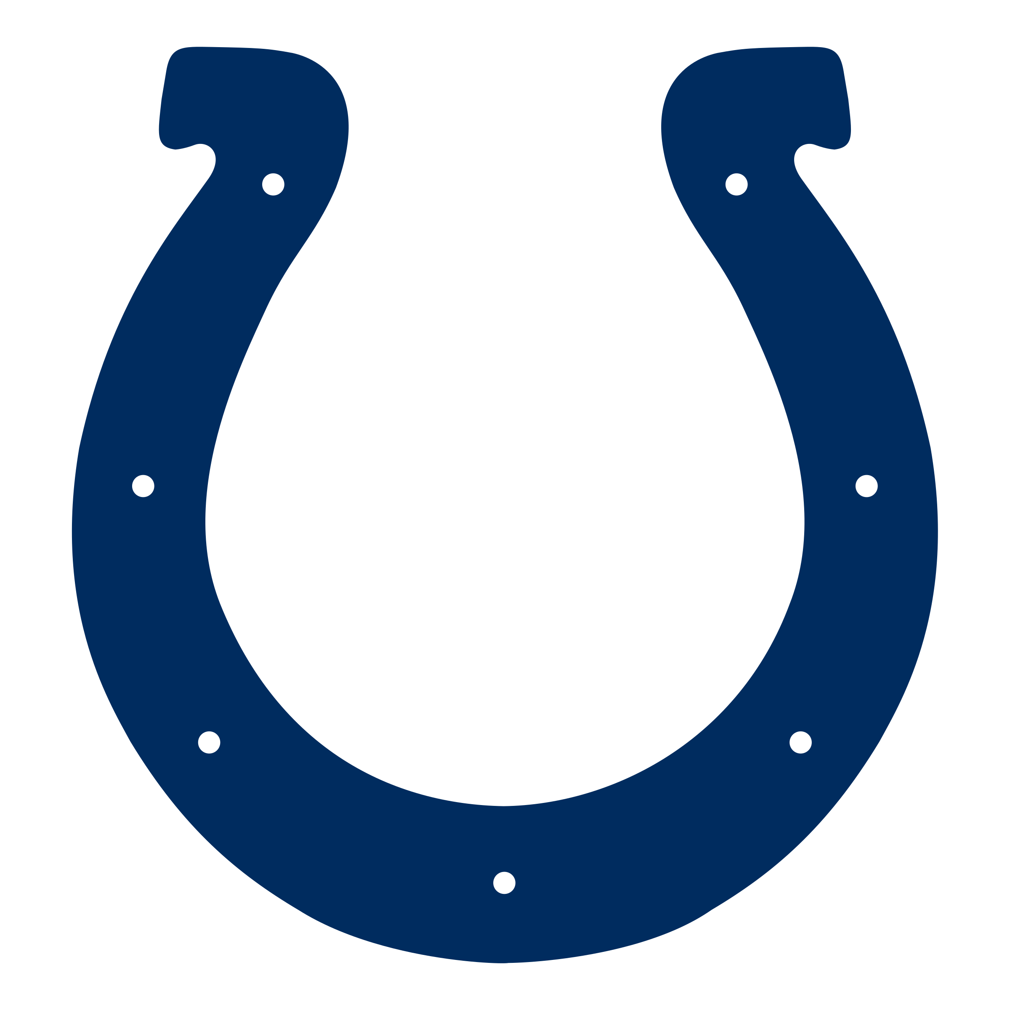
COLTS X FANDUEL
PARTNERSHIP PROPOSAL
DANIEL BARIR JENSEN

Slide 2
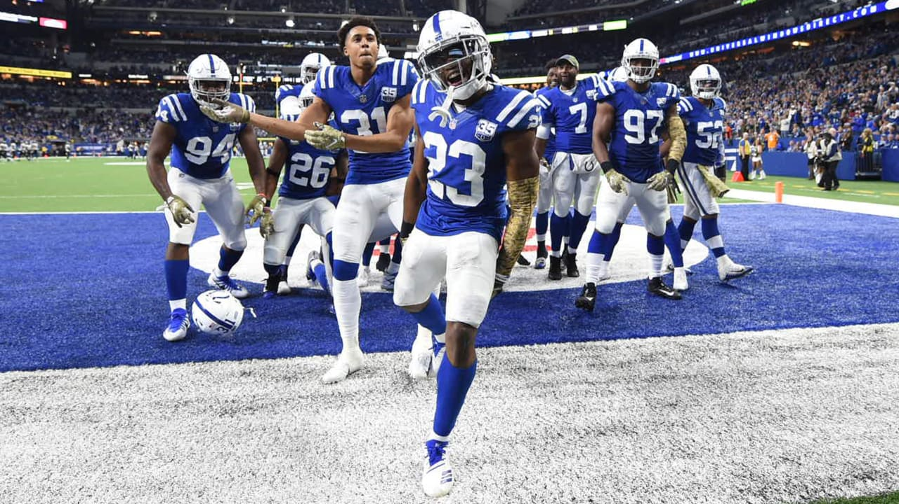
TABLE OF CONTENTS
PARTNERSHIP OPPORTUNITY 3
POWER OF THE COLTS 7
COLTS FAN INSIGHTS 8
PARTNERSHIP IMPACTS 13
INVESTMENT SUMMARY 15

Slide 3
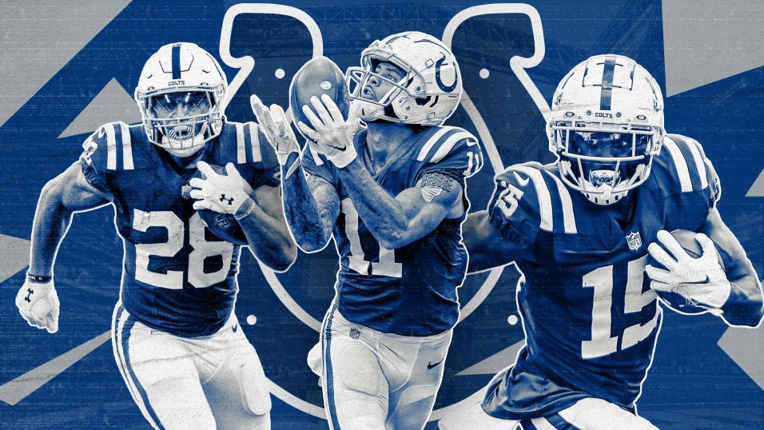
PARTNERSHIP OPPORTUNITY
3

Slide 4
THE OPPORTUNITY
Putting sports fans at the heart of
everything we do
Entertain, inspire and unite by
winning the right way
Make sports more exciting
4

Slide 5
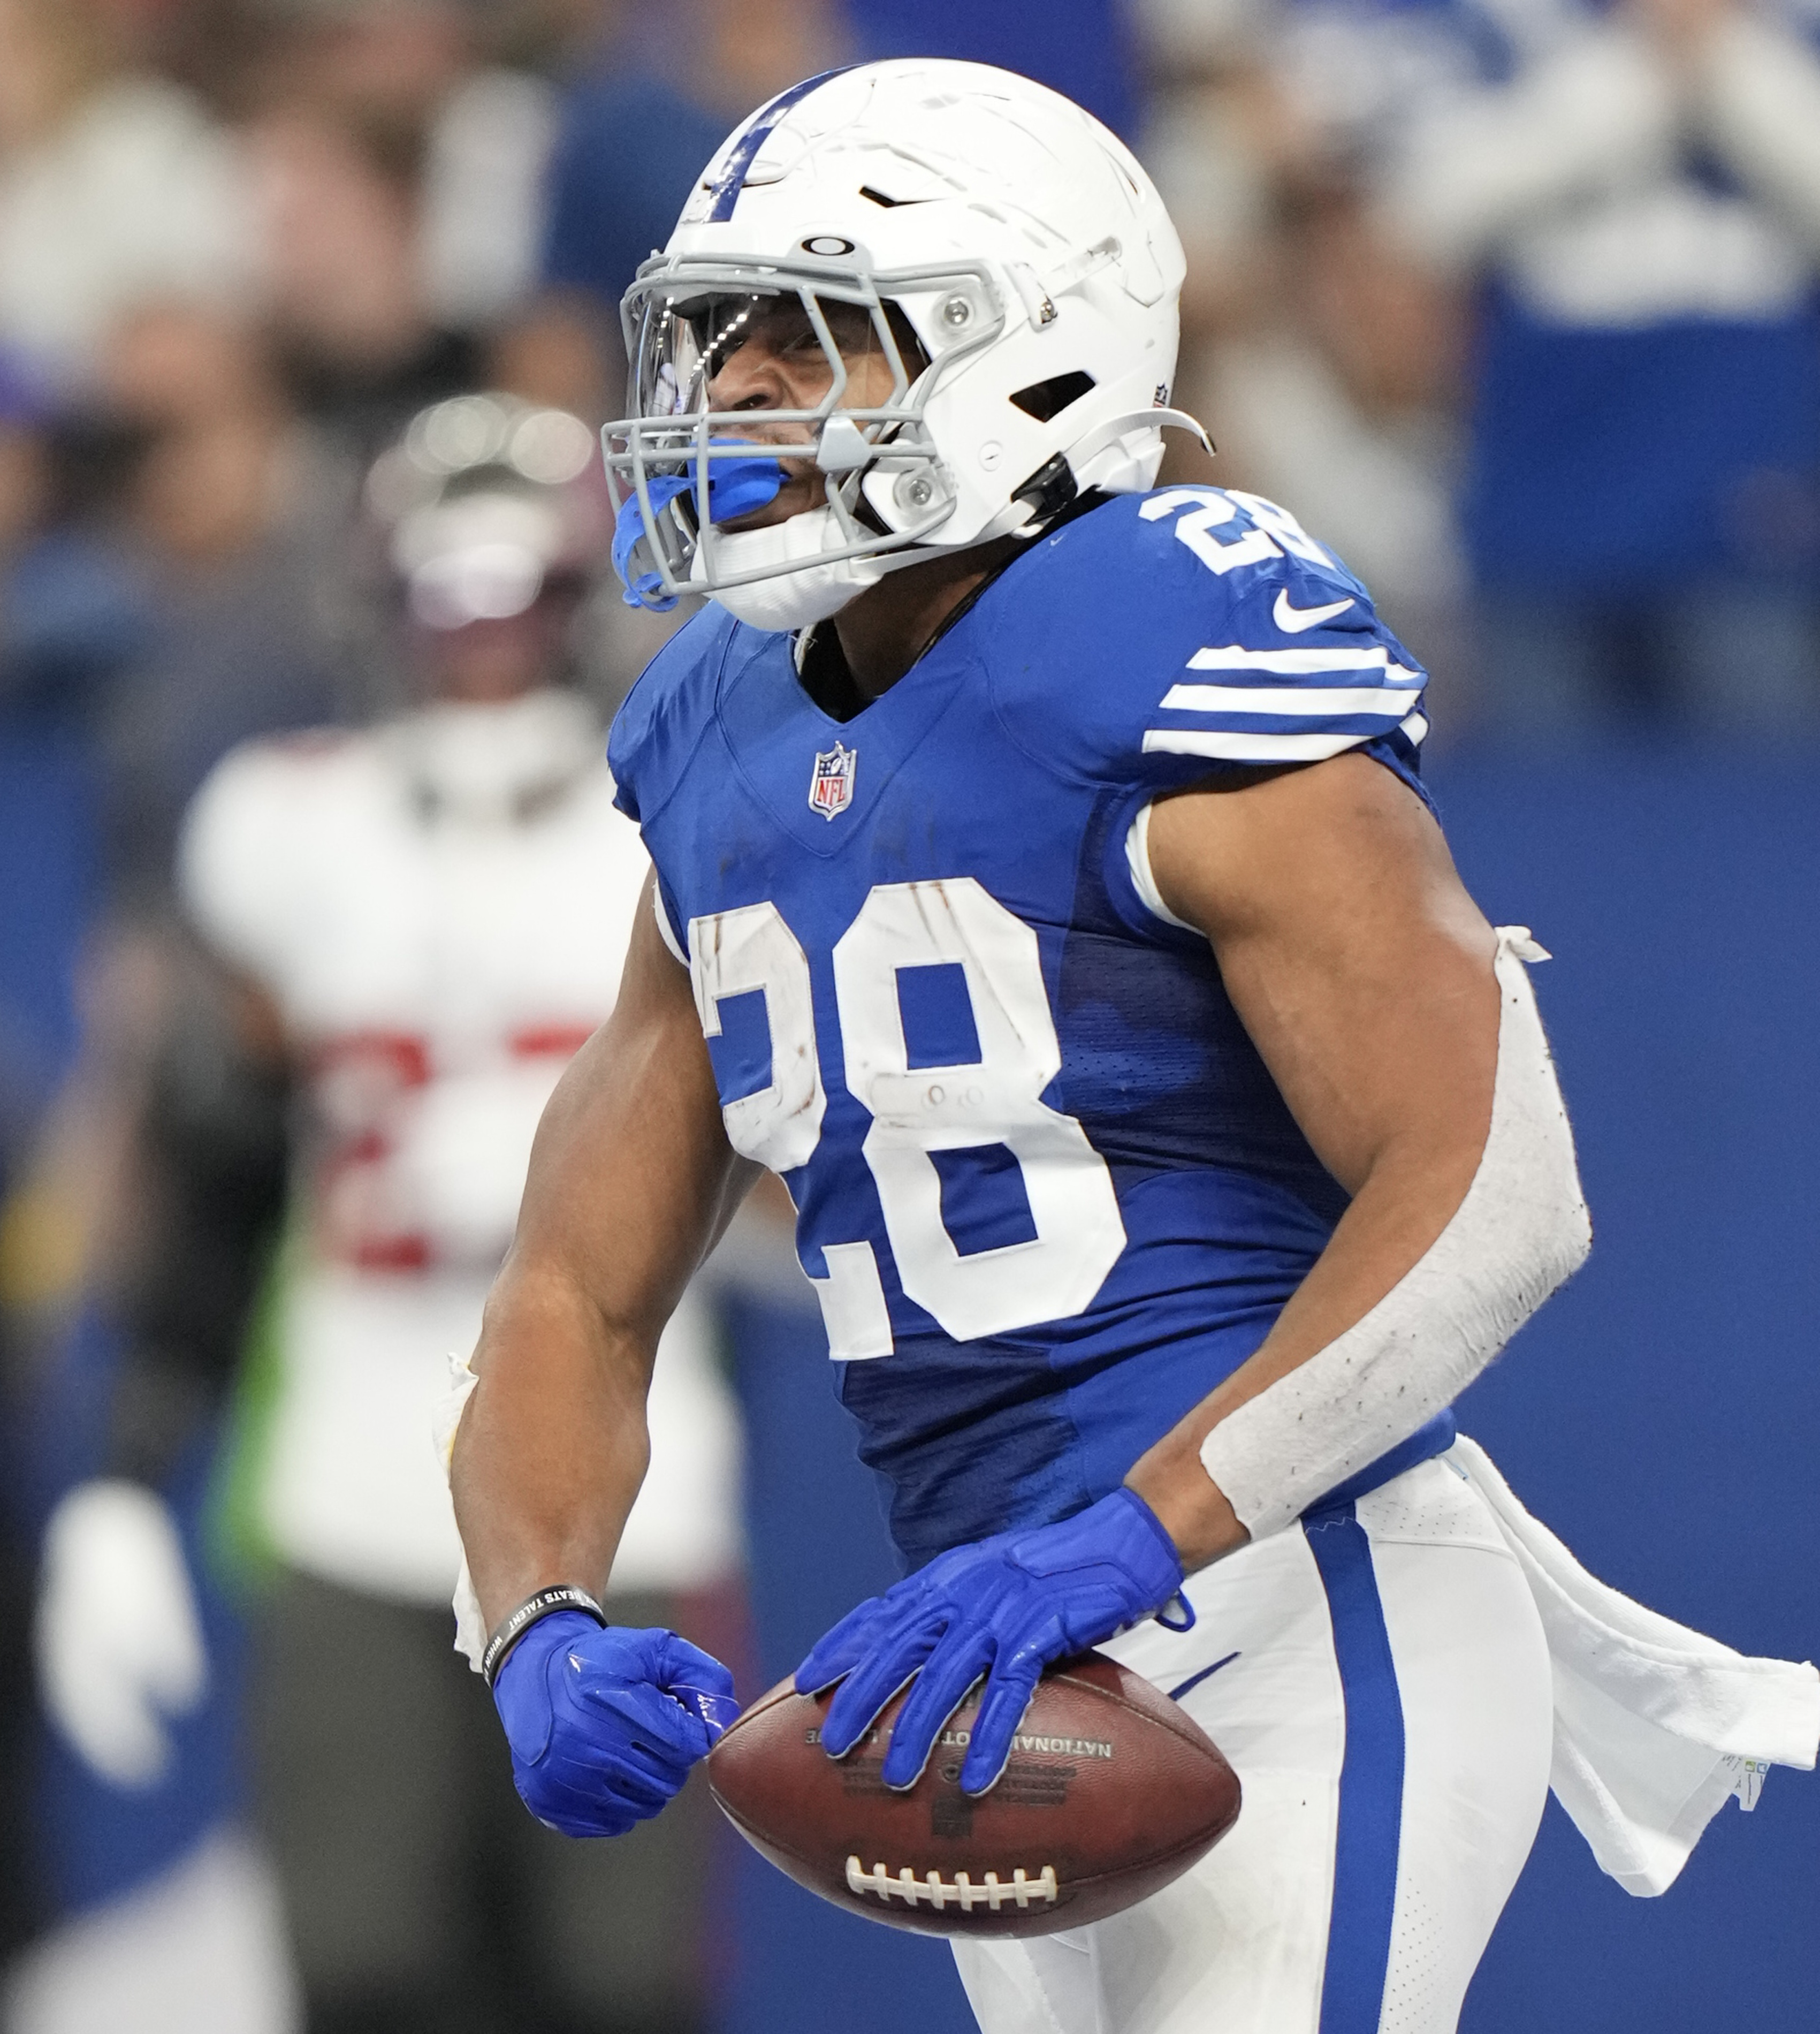
THE OBJECTIVES
BRAND AWARENESS
Showcase the FanDuel brand and secure multiple locations throughout Lucas Oil Stadium for fan engagement opportunities throughout the year
Drive credibility with Colts fans by becoming exclusive sports betting partner
Enhance FanDuel messaging through dedicated promotions & amplification in digital, social, traditional media and in-stadium concourse signage
MARKET PENETRATION
Incentivize new members through tailored promotions and sign-up bonuses
Utilize Colts IP and “Register To Win” promotion to drive incremental revenues
Incentivize FanDuel associates and strengthen their relationship with key customers through VIP hospitality and experiences
5

Slide 6
POWER OF THE COLTS
6

Slide 7
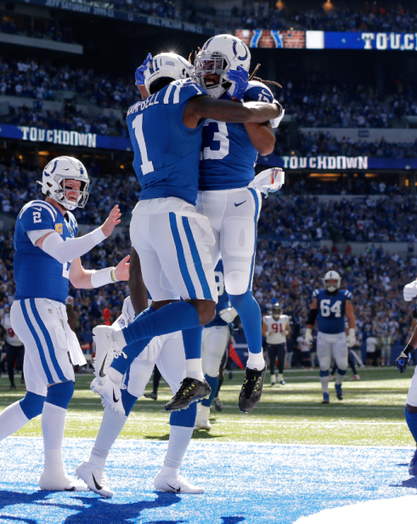
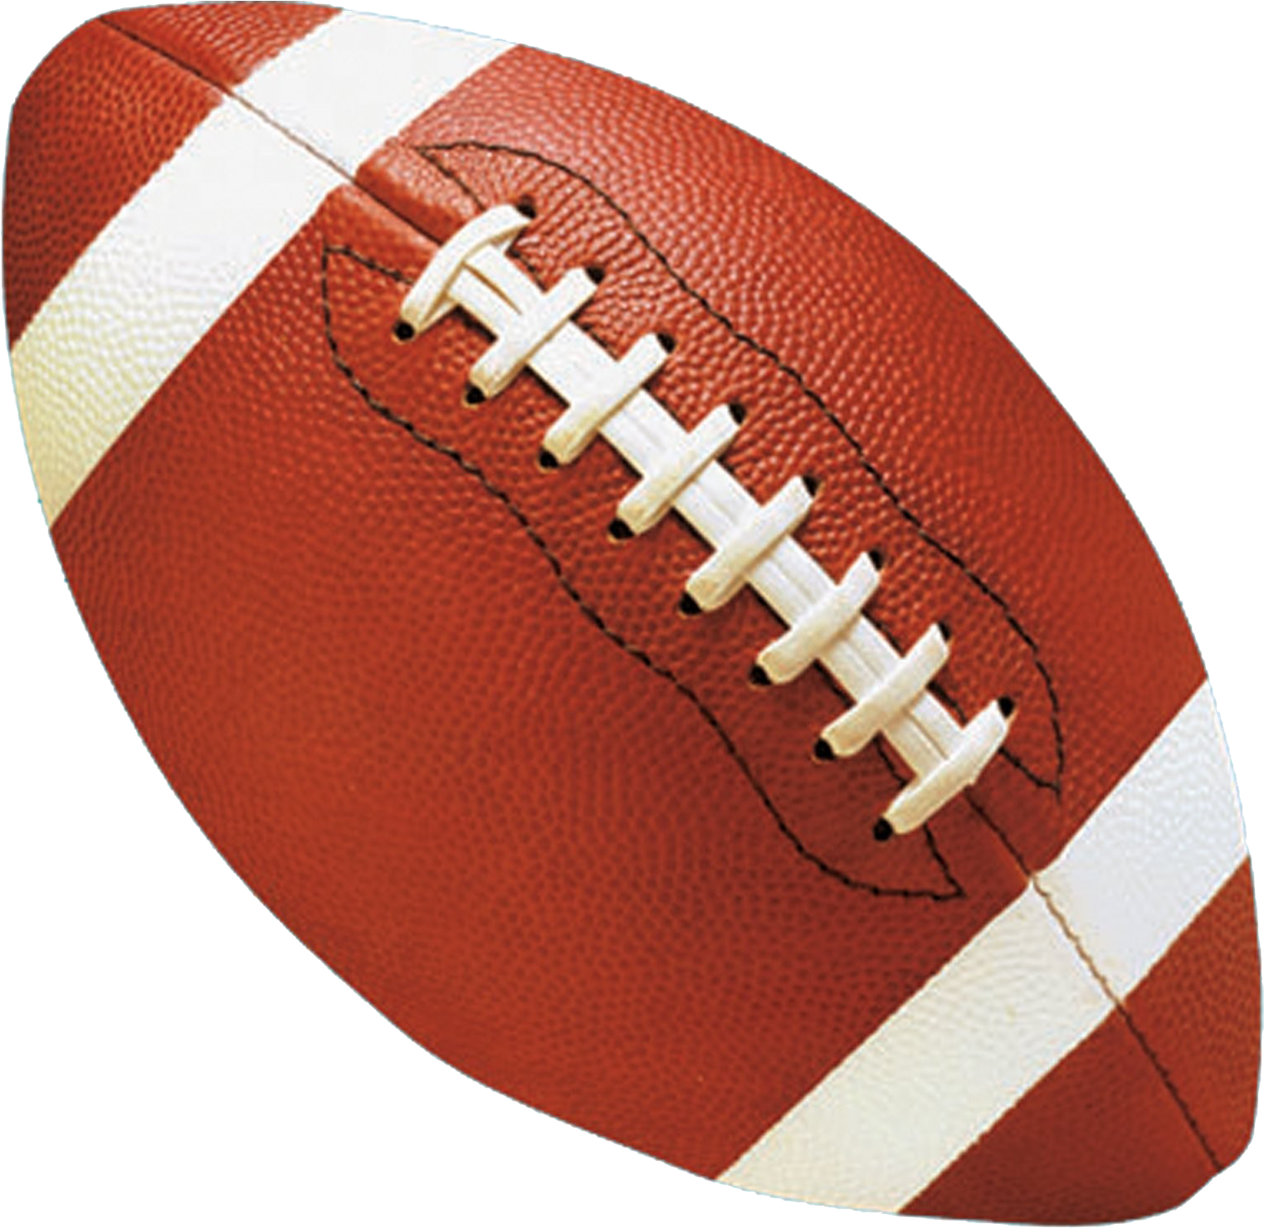
POWER OF THE COLTS BRAND
1.78M
IN INDIANA
FANS
2.18M
IN THE MIDWEST
FANS
6.18M
NATIONALLY
FANS
The Indianapolis Colts are the #1 Sports & Entertainment brand in Indiana with the largest fanbase in the state of any sports team and competing in the #1 sports league and most powerful entertainment brand in the country
7
Source: YouGov Profiles+ USA 2021-11-07

Slide 8

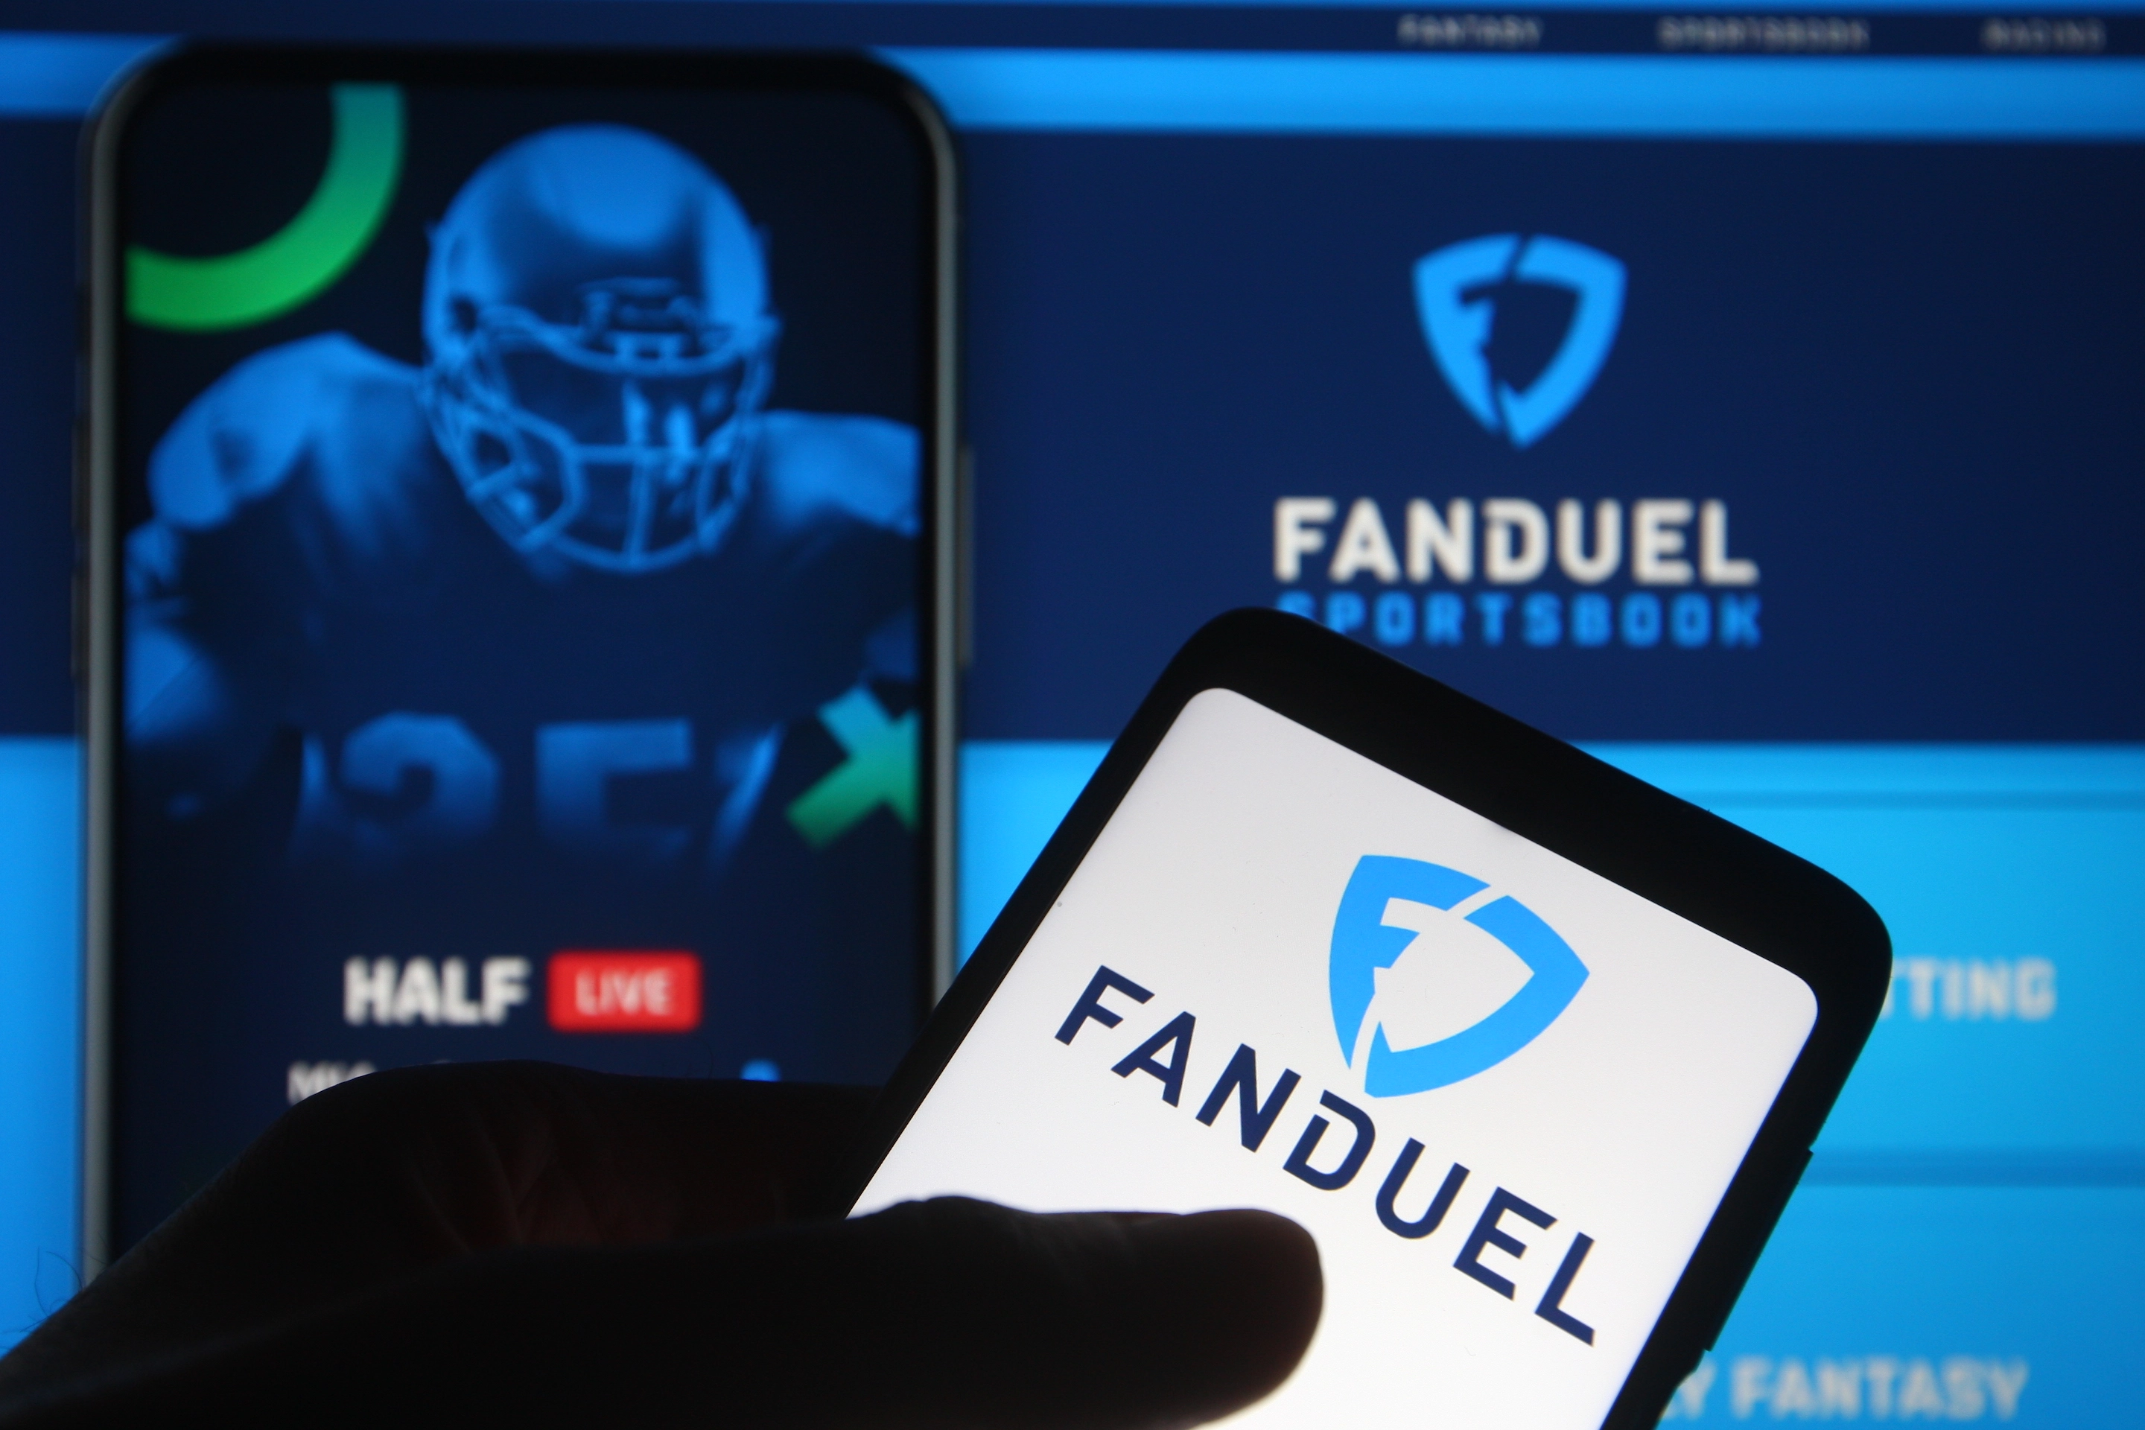
THE COLTS ATTITUDE
“I’M INTERESTED IN BETTING AND
GAMBLING ONLINE”
COLTS FANS ARE 2.73x MORE
LIKELY TO AGREE
Colts fans demonstrate a positive attitude towards sports betting:
2.77x more likely to feel engaged
2.35x more likely to be interested in online betting options
These findings support the notion that the Colts fanbase is an ideal target group for FanDuel in the company’s pursuit of increasing brand awareness and market penetration
“BETTING HELPS ME FEEL MORE ENGAGED
WITH THE SPORTS I LIKE”
COLTS FANS ARE 2.77x MORE
LIKELY TO AGREE
Source: YouGov Profiles+ USA 2022-06-19
8

Slide 9
COLTS FAN INSIGHTS
9

Slide 10
COLTS FANS PLACE ONLINE SPORTS BETS MORE FREQUENTLY
When comparing Colts fans to regular Indiana state residents, we see that Colts fans over-index in almost every sports betting consumption frequency measure
2.57% of, or 163,000 Colts fans, place a sports bet online daily, which over-indexes greatly compared to Indiana state residents
Colts fans also over-index in other categories of frequency:
4.8% (305K) of Colts fans place online bets several times a week
1.85% (118K) of Colts fans place online bets once a week
2.82% (180K) of Colts fans place online bets several times a month
FREQUENCY
BONUS
9.03% (575K) of Colts fans have spent between $30,000-$39,000 on sports betting in the past 12 months
Source: YouGov Profiles+ USA 2022-06-19
10

Slide 11
COLTS FANS ARE AVID USERS OF FANTASY SPORTS
Overall, Colts fans as a whole are much more likely than non-fans to engage with fantasy sports
3.4% of, or 250,000 Colts fans, play fantasy sports online daily, which over-indexes greatly compared to Indiana state residents.
Colts fans also over-index in all other categories of frequency:
3.94% (250K) of Colts fans play several times a week
2.0% (127K) of Colts fans play once a week
3.37% (215K) of Colts fans play several times a month
1.31% (83K) of Colts fans play once a month
FREQUENCY
BONUS
30% of Colts fans have played NFL Fantasy in the past 12 months in comparison to only 4.38% of Indiana state residents
Source: YouGov Profiles+ USA 2022-06-19
11

Slide 12
COLTS FANS ARE PRIMED FOR BRAND AWARNESS INITIATIVES
Colts fans demonstrate a greater consideration and purchase intent for your brand with plenty of opportunity for growth
14.63% of, or 930,000 Colts fans, would consider using FanDuel in the market for gambling, which over-indexes 2.07x relative to the overall population of Indiana state residents.
3.5% of, or 225,000 Colts fans, would most likely use FanDuel over other brands in the market for gambling, which over-indexes 1.31x relative to the overall population of Indiana state residents. We envision that a potential partnership between FanDuel and the Colts would lead to substantial growth in this index
CONSIDERATION
PURCHASE INTENT
2.07x
1.31x
Source: YouGov Profiles+ USA 2022-06-19
12

Slide 13
PARTNERSHIP IMPACTS
13

Slide 14
PARTNERSHIP IMPACTS
2.04x
ATTENTION
2.35x
LOYALTY
Partnering with the Colts provides access to an attentive, loyal and active fanbase. Through research gathered from YouGov surveys, we can see how our fans compare in their attitudes towards advertising and sponsorships relative to other Indiana state residents
Colts fans are 2.04x more likely to take notice of who sponsors the sports events they watch
Colts fans are 2.35x more likely to support their team by buying products from its sponsors
1.88x
WORD OF MOUTH
Source: YouGov Profiles+ USA 2022-06-19
Colts fans are 1.88x more likely to recommend things to their friends and family that they have seen advertised
14

Slide 15
INVESTMENT SUMMARY
15

Slide 16
PUTTING SPORTS
FANS AT THE HEART OF EVERYTHING WE DO
INVESTMENT: TBD CONTACT: 646-123-4567
TERM: TBD DBJ@COLTS.COM
ANNUAL ESCALATOR: TBD
PLAYOFFS: TBD
16

